Slide 1
BREAK THE CHAIN
KESHAV SINGH THAKUR (18103003)
PRATHU SINGAL (18103085)
RAJAN BHAJAT (18103091)
MUNISH KUMAR GARG (18103120)

Slide 2
PROBLEM STATEMENT
Coronavirus has changed the way we live. Social distancing at public places is the only way to fight with the virus till a vaccine is discovered.

Slide 3
PROPOSED SOLUTION
APPLICATION THAT CAN MONITOR
SOCIAL DISTANCING AT PUBLIC
PLACES USING CCTV CAMERAS

Slide 4
APPLICATION FEATURES
COVID-19 STATS
02
DISTANCE ALERTER
01
HEALTH NEWS
03
Daily covid-19 cases for Districts of India
AI based social distance monitoring using mobiles camera
Current health news to keep people aware

Slide 5
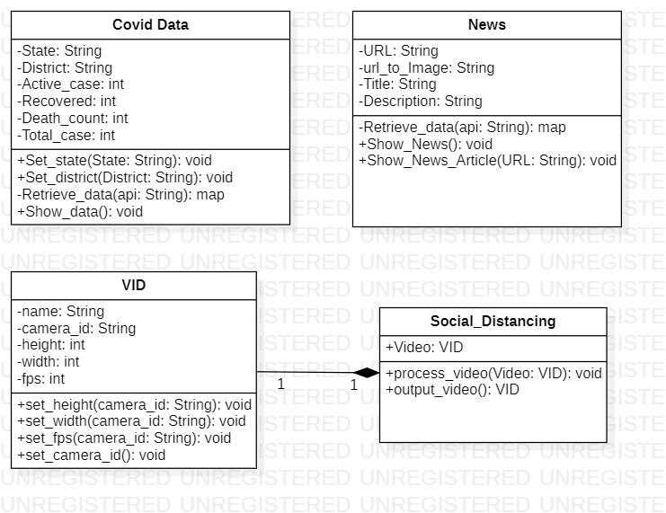
CLASS DIAGRAM

Slide 6
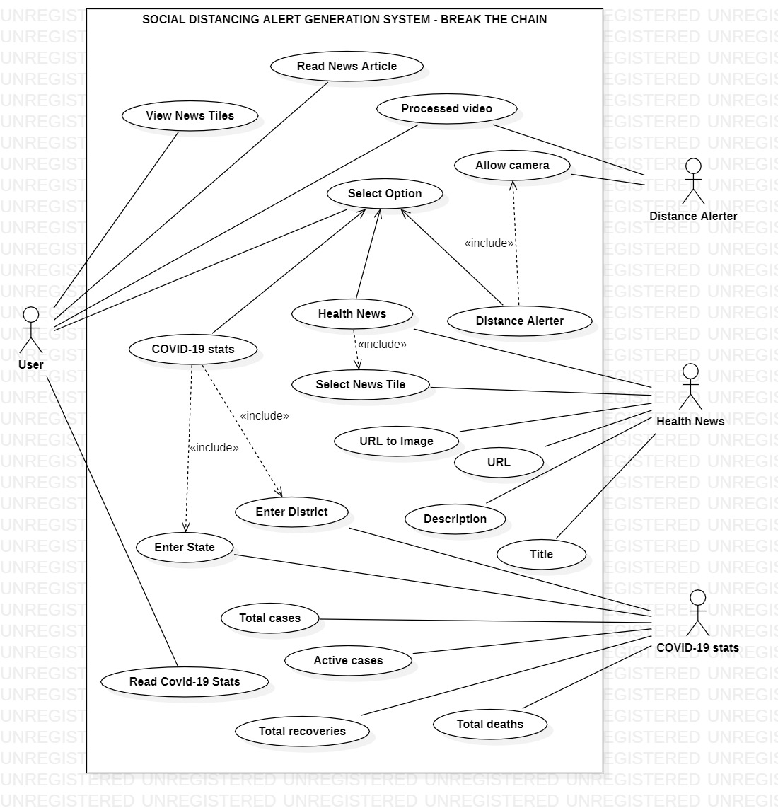
USE CASE DIAGRAM

Slide 7
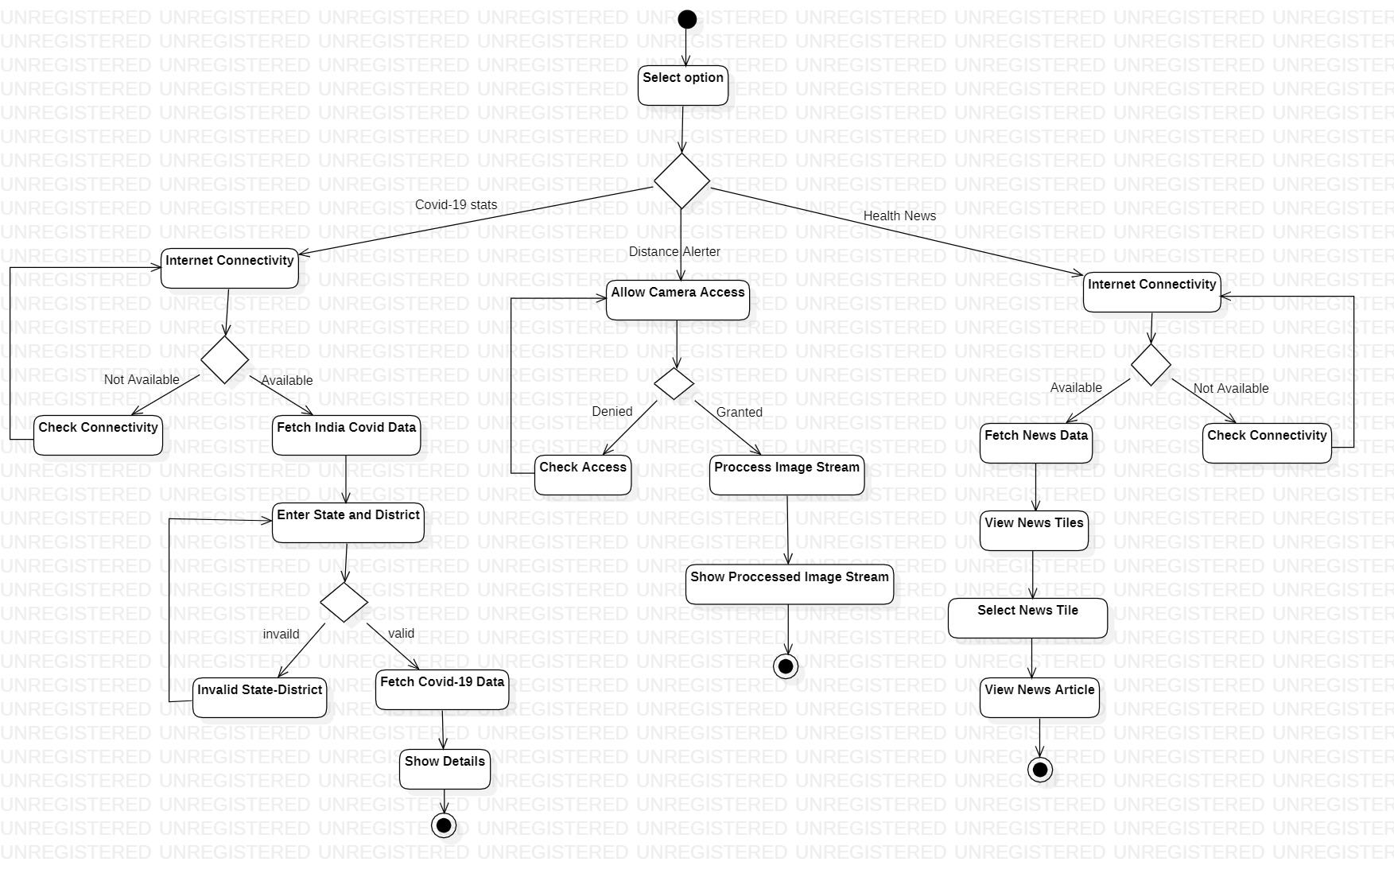
ACTIVITY DIAGRAM

Slide 8
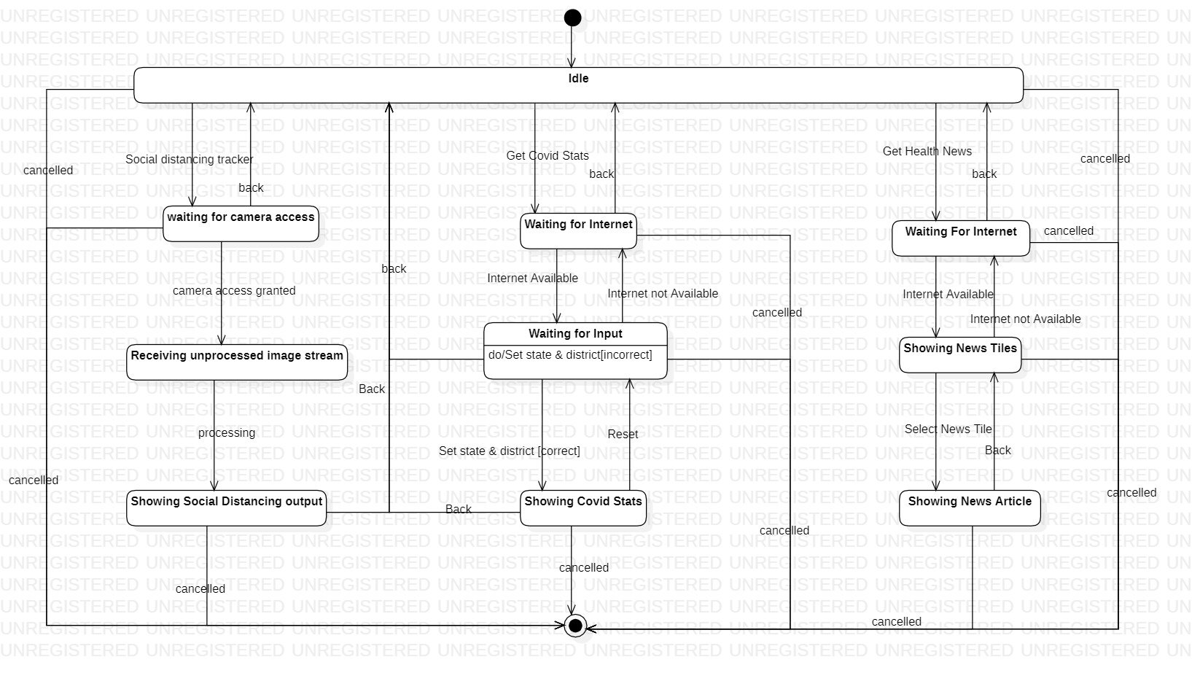
STATE CHART DIAGRAM

Slide 9
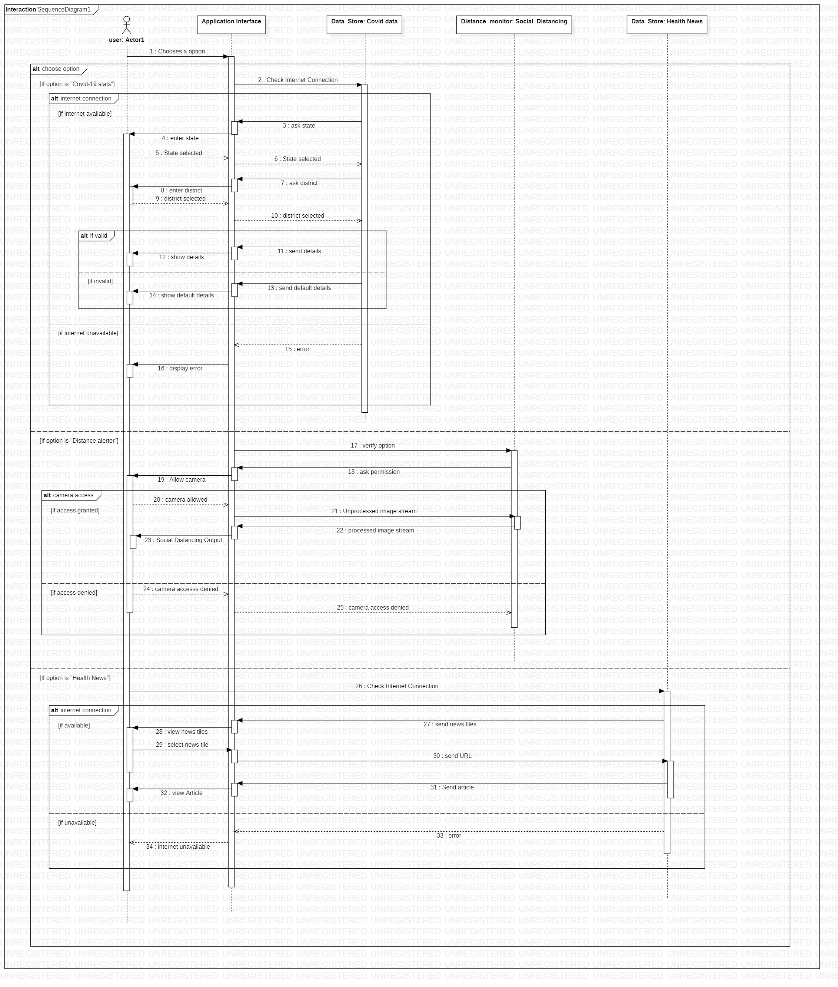
SEQUENCE DIAGRAM

Slide 10
TECHNOLOGIES USED
FLUTTER
ARTIFICIAL INTELLIGENCE
DART
ANDROID STUDIO
COVID19-INDIA API
To get COVID-19 stats & patient tracing in India
Software Development Kit used to make mobile apps for android and IOS
SSD-MobileNet object detection model to monitor social distancing
Programming language used to make apps using flutter
IDE for Android app development with fast and feature-rich emulator
NEWS API
To get Health related news headlines and articles

Slide 11
PROJECT EXECUTION

Slide 12
PROF. RAJESH BHATIA SOFTWARE ENGINEERING (CSN–302)
THANK YOU!

